Slide 1
C/C++ Program Design
LAB 1

Slide 2
Qimei Liao（廖琪梅）
Email: liaoqm@mail.sustech.edu.cn
Office: Room 509 , Building 10, Innovation Park

Slide 3
CONTENTS
Download and install GCC on Windows 10 (Based on Windows Subsystem for Linux)
Download and install LLVM on macOS
Download and install GCC on Windows x (Based on Cygwin)
Compile, link and run C/C++ programs
Download and install the editor (VSCode)
Exercises

Slide 4
1 Download and install GCC on Windows 10 (Based on WSL)
1.1 Install WSL on Windows 10
1.2 Install GCC (the GNU Compiler Collection) on WSL
1.3 Verify GCC on WSL

Slide 5
1.1 Install WSL on Windows 10
Step one: enable the Windows Subsystem for Linux
Open powershell as Administrator and run: dism.exe /online /enable-feature /featurename:Microsoft-Windows-Subsystem-Linux /all /norestart

Slide 6
input 命令提示符

Slide 7
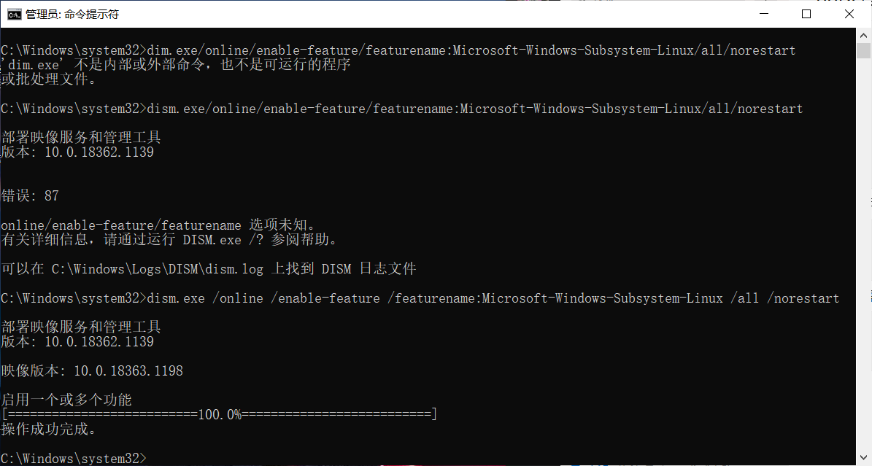
Notice the space in the commands

Slide 8
1.1 Install WSL on Windows 10(cont.)
Step two: restart your machine
Step three: install your Linux distribution of choice:
Open the Microsoft Store and select your prefered Linux distribution
Search Linux in Microsoft Store

Slide 9
input store

Slide 10
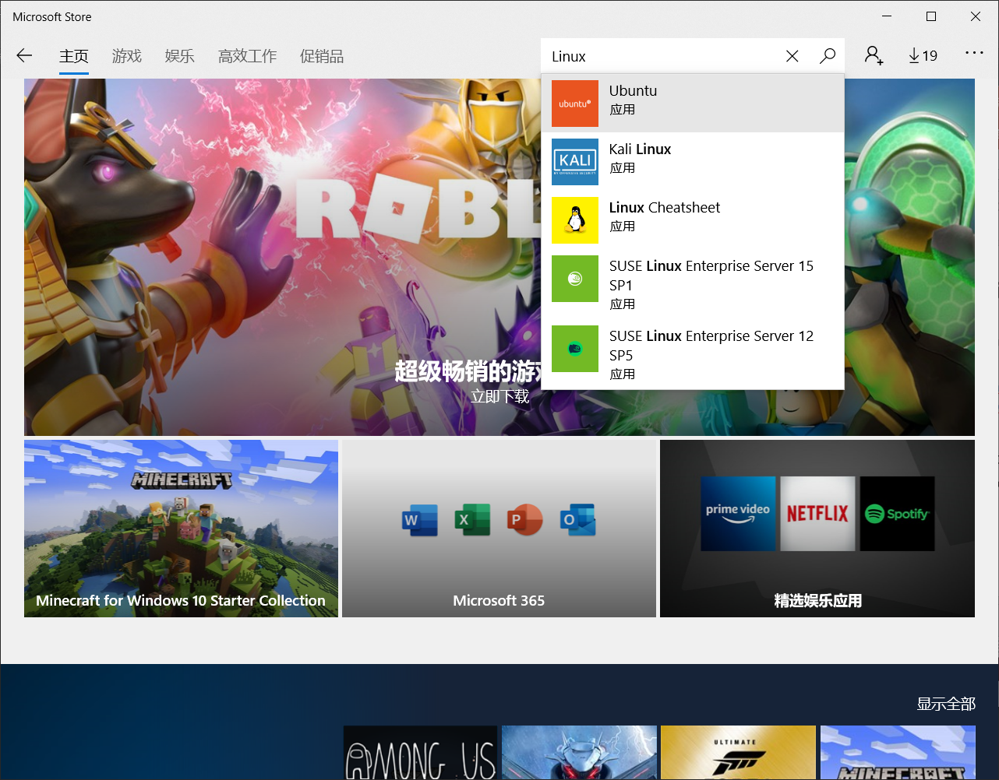
search Linux
select Ubuntu 应用

Slide 11
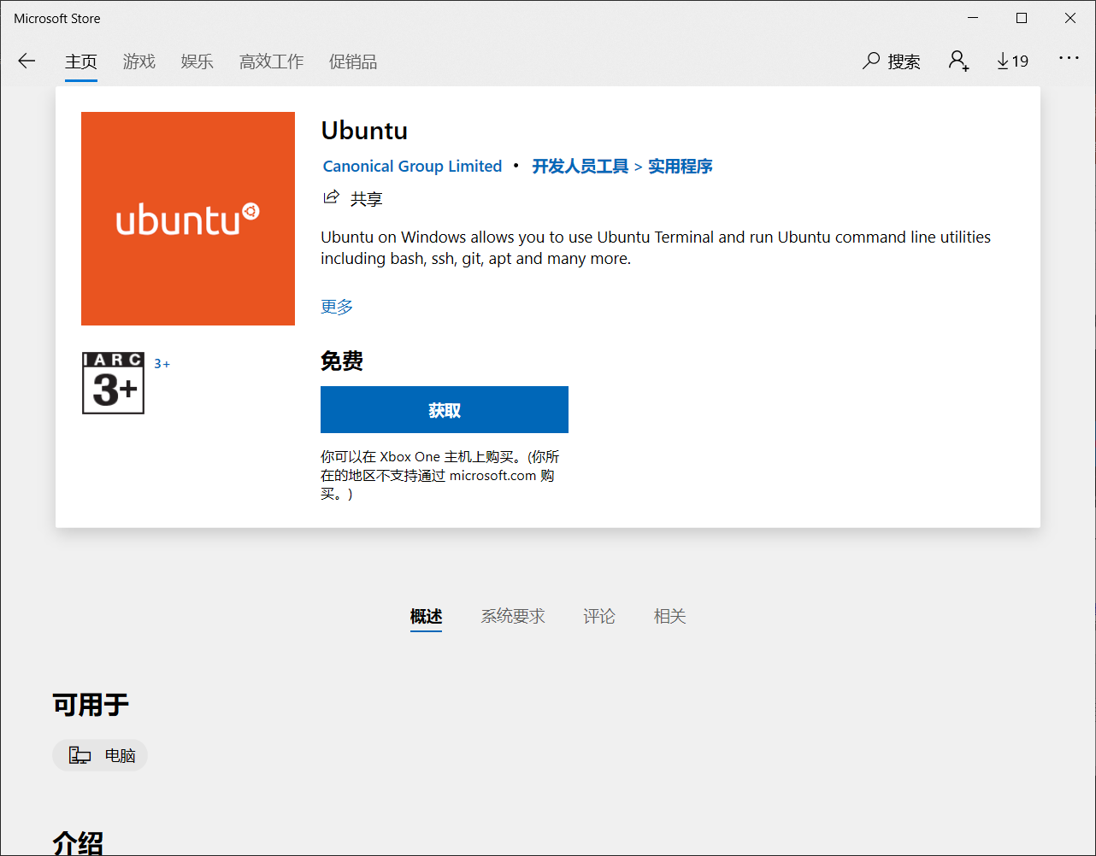

Slide 13
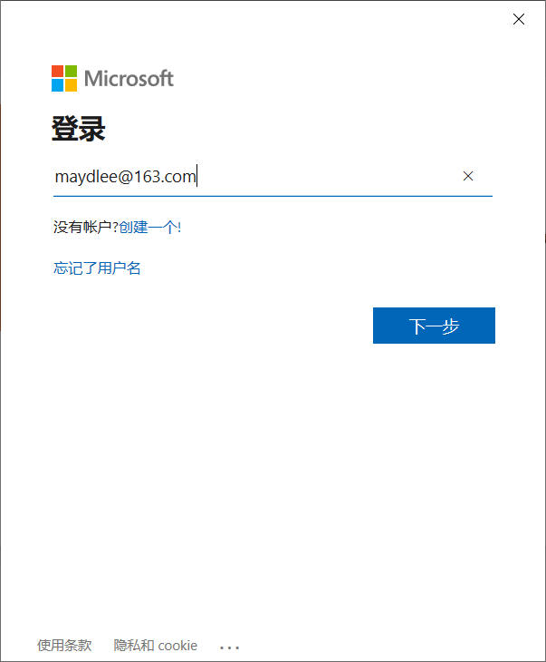
input your Microsoft account
If you have no account, you can create one

Slide 14
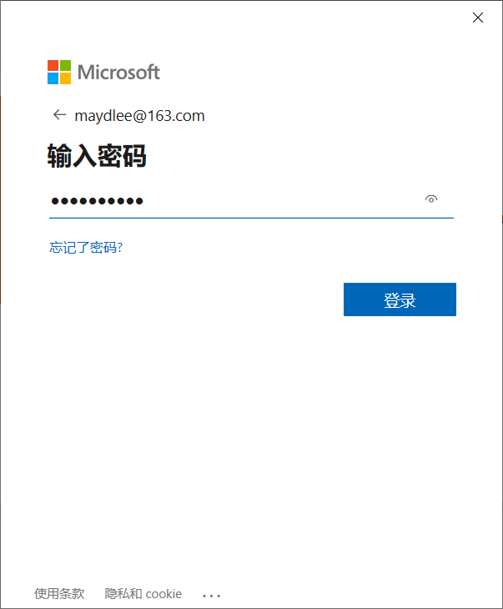
input your password

Slide 15
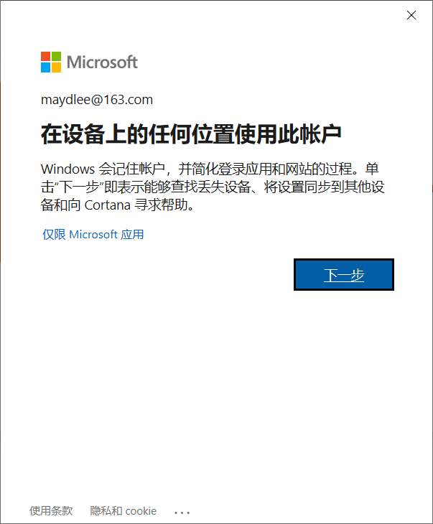

Slide 16
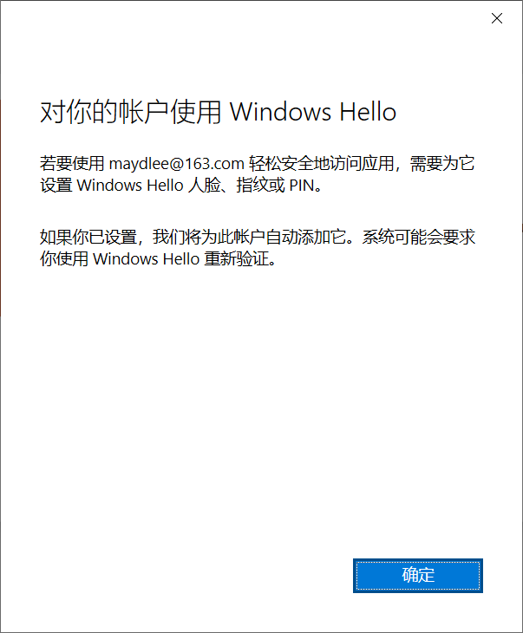

Slide 19
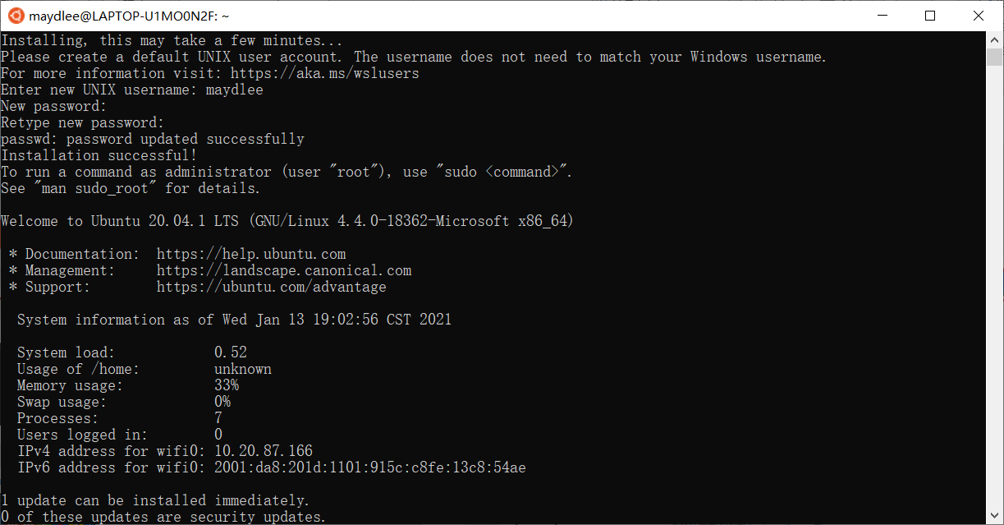

Slide 20
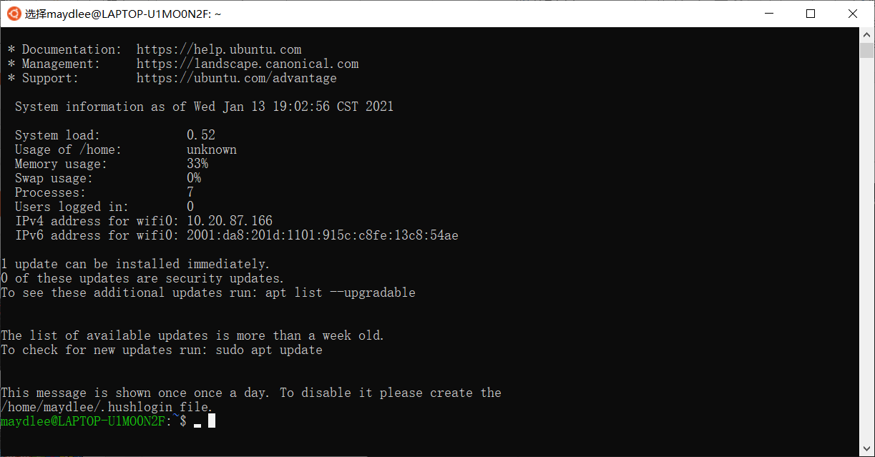

Slide 21
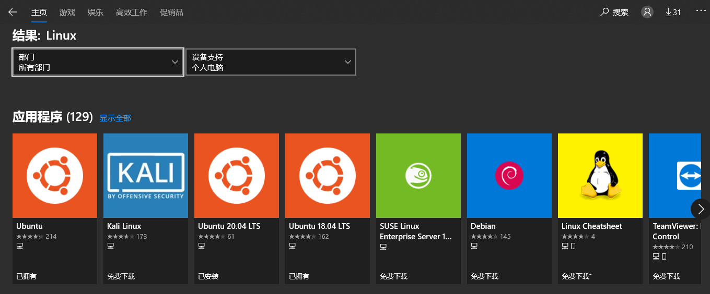
1.1 Install WSL on Windows 10 (Cont.)
We prefer Ubuntu 20.04 LTS and use this as an example in our class as this is the latest LTS version.
If your are interested in WSL2 which supports more features of Linux (like Docker) you can visit: https://docs.microsoft.com/zh-cn/windows/wsl/install-win10#manual-installation-steps for more information.

Slide 22
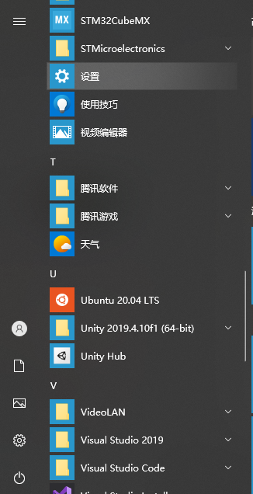
1.2 Install GCC on WSL
Once you finished the installation of Ubuntu 20.04 LTS, you can find it on your start menu.
Open it and you will see a Terminal for Linux
You can set username and password for your system (Please remember this password as you need it to switch to root user later)

Slide 23
1.2 Install GCC on WSL (Cont.)
You can change the source list of apt if you want. (This step may improve your download speed later)
For more information you can visit: https://mirrors.sustech.edu.cn/help/ubuntu.html#introduction
Use the command below to install GNU: (If you are using any Linux distribution based on debian you can use below to install, too)
sudo apt update;sudo apt install g++ -y
The first command will update your apt library (apt:Advanced Packaging Tools)
The second will install g++ and its independence

Slide 24
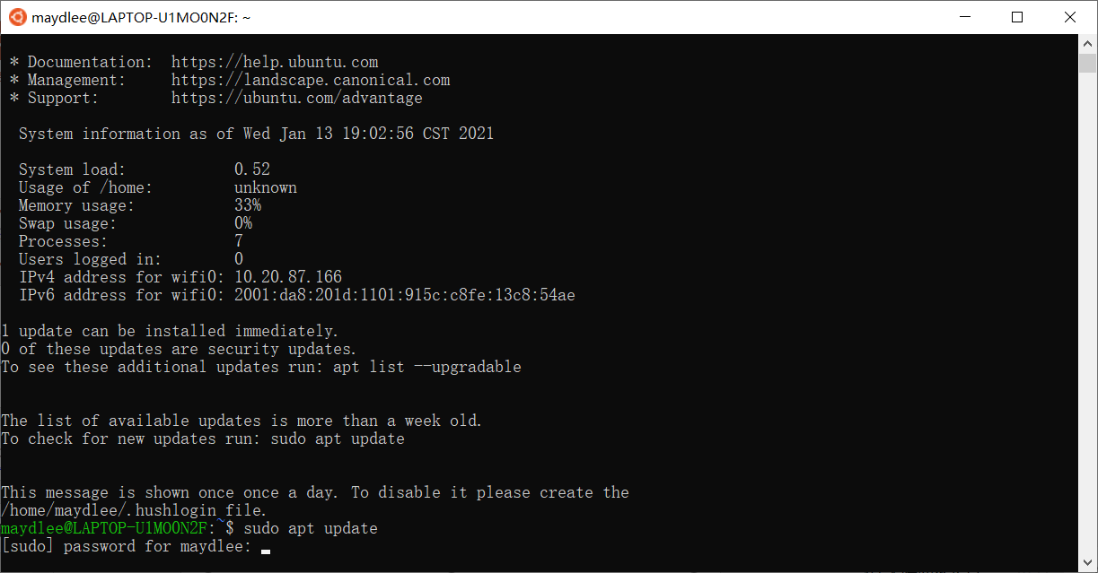

Slide 25
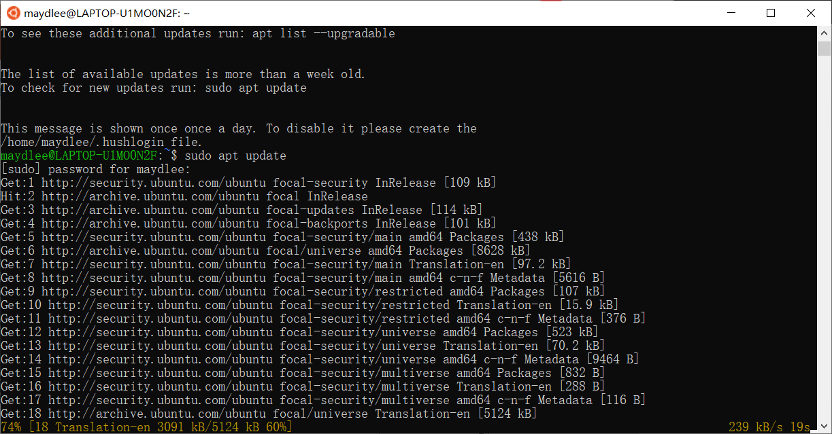

Slide 26
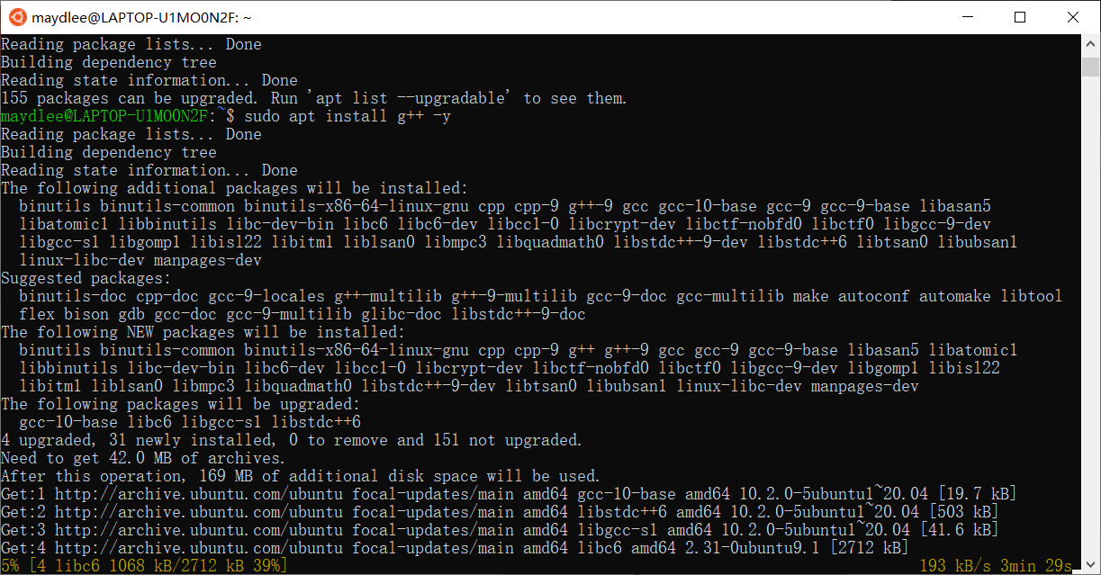

Slide 27
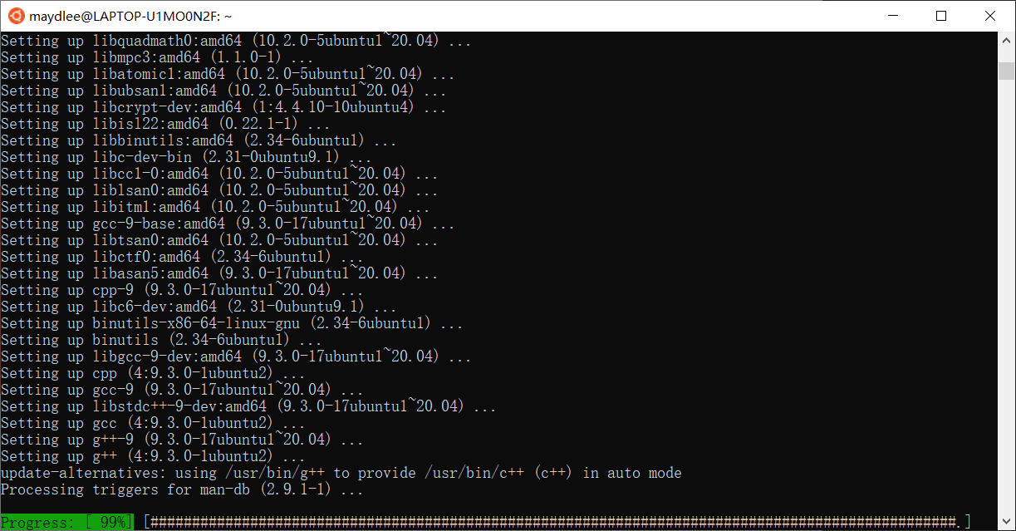

Slide 28
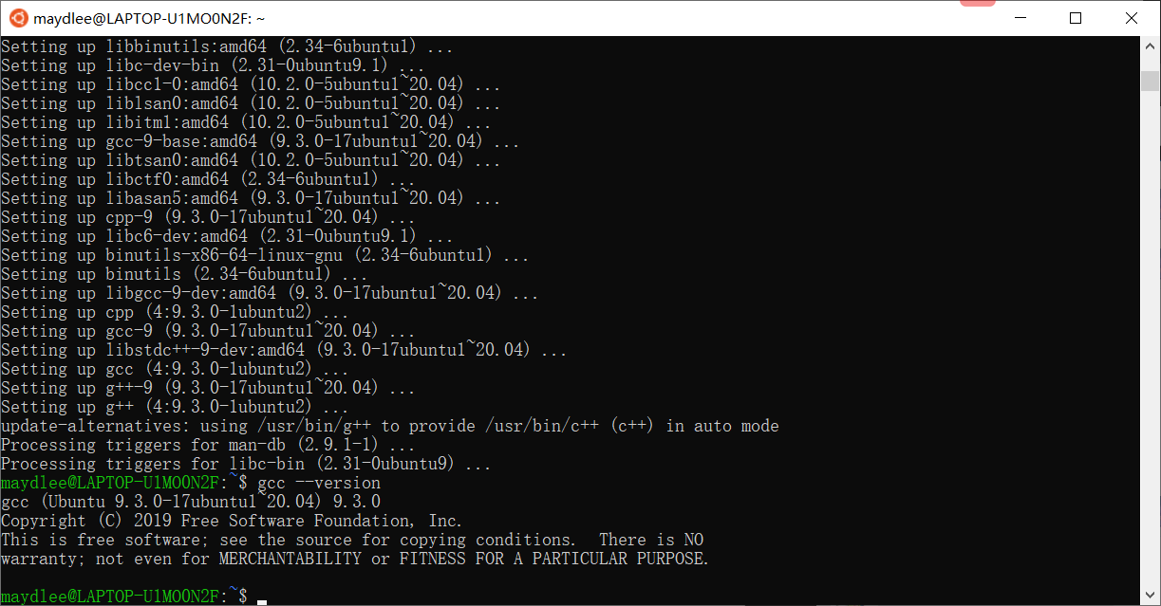
1.3 Verify GCC on WSL
You can input command: gcc --version to check whether the GCC is installed well

Slide 29
2 Download and install LLVM on macOS
2.1 Install Command Line Tools on macOS
2.2 Verify the LLVM

Slide 30
2.1 Install CLT on macOS
Open the Terminal on your Mac
Input g++ to check whether the CLT or GCC is installed
If not, the system will guide you to install CLT
You can also install CLT by package provided by Apple: https://developer.apple.com/download/more/

Slide 31
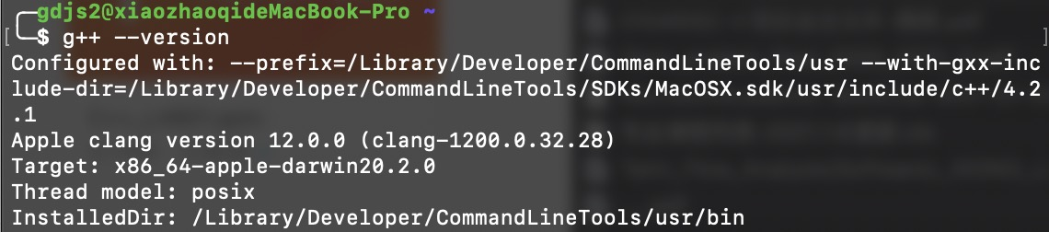
2.2 Verify LLVM on macOS
The same as verifing GNU, using: g++ --version

Slide 32
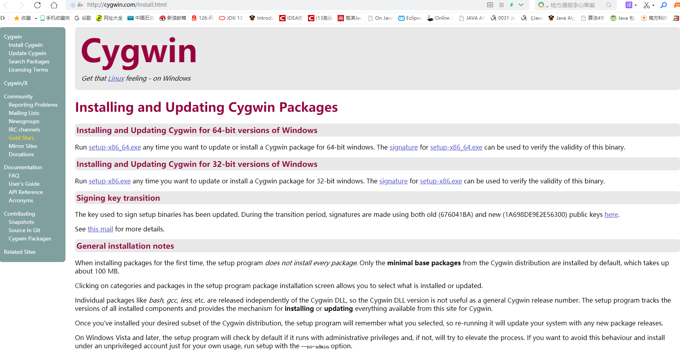
3.1 Install Cygwin
Download url: http://cygwin.com/install.html
Select an appropriate version to download based on your OS

Slide 33
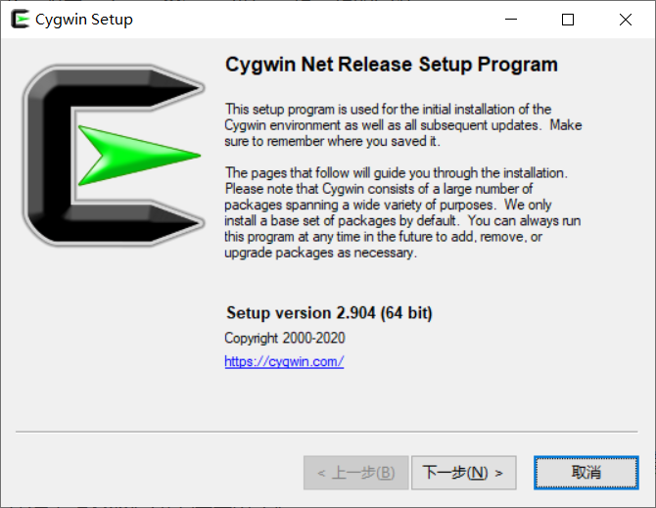
1. When the download is completed, you can double-click the setup-x86_64.exe to run the installer.
click Next

Slide 34
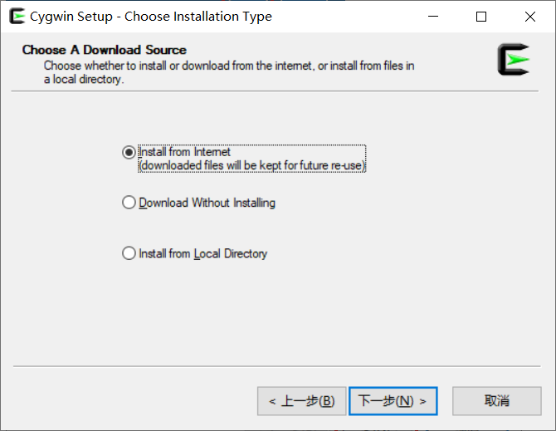
Choose Install from Internet
click Next

Slide 35
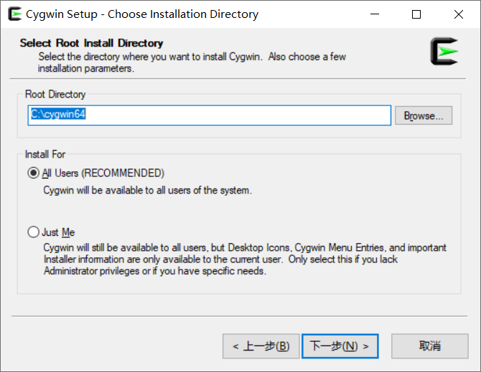
Choose Install Directory
Clicking Browse button can change the Install Directory
Choose All Users
click Next

Slide 36
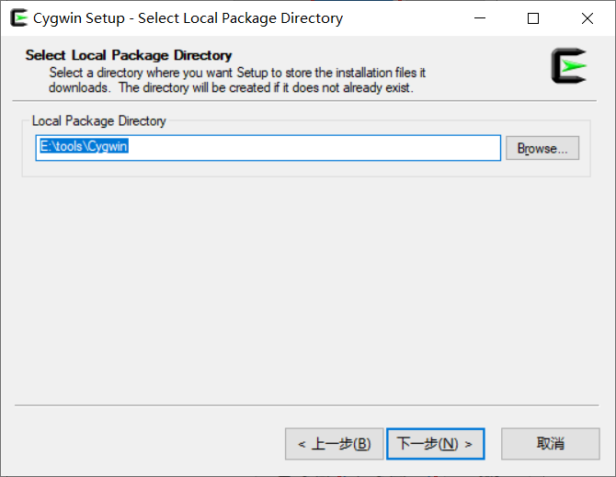
Choose the local package directory where you would like your installation files to be placed.
click Next

Slide 37
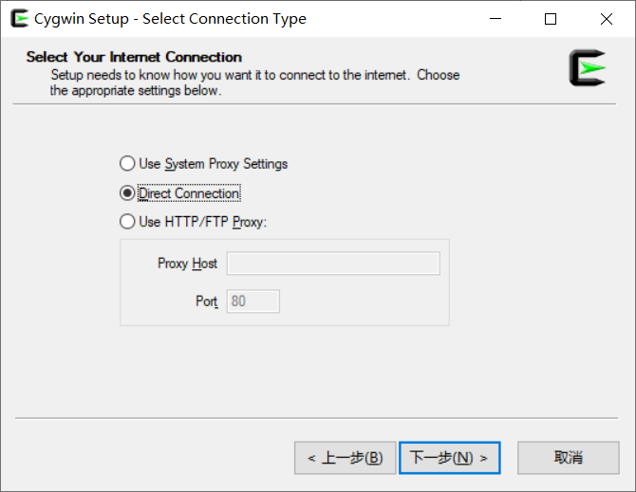
Choose Direct Connection
click Next

Slide 38
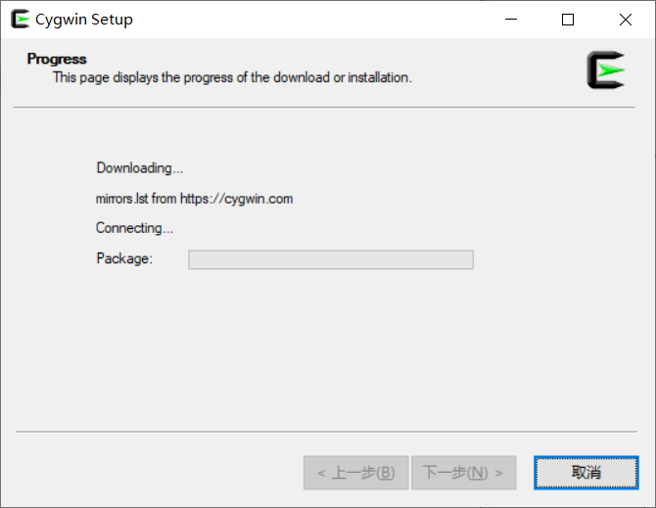
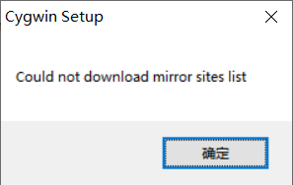
Downloading the mirror sites
If it failed to download , click OK

Slide 39
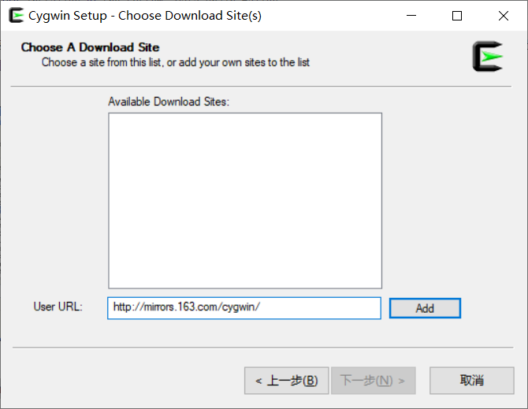
Input http://mirrors.163.com/cygwin/ and click Add

Slide 40
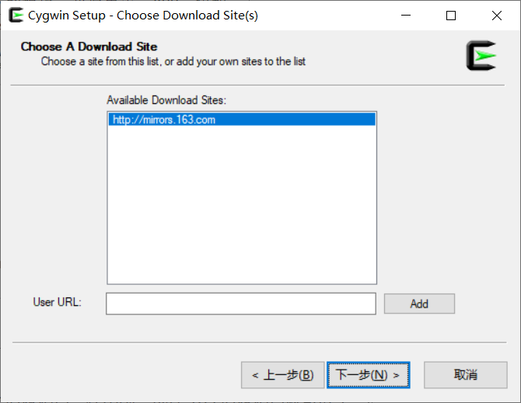
The mirror site adds to the Available Download Sites, choose it
click Next

Slide 41
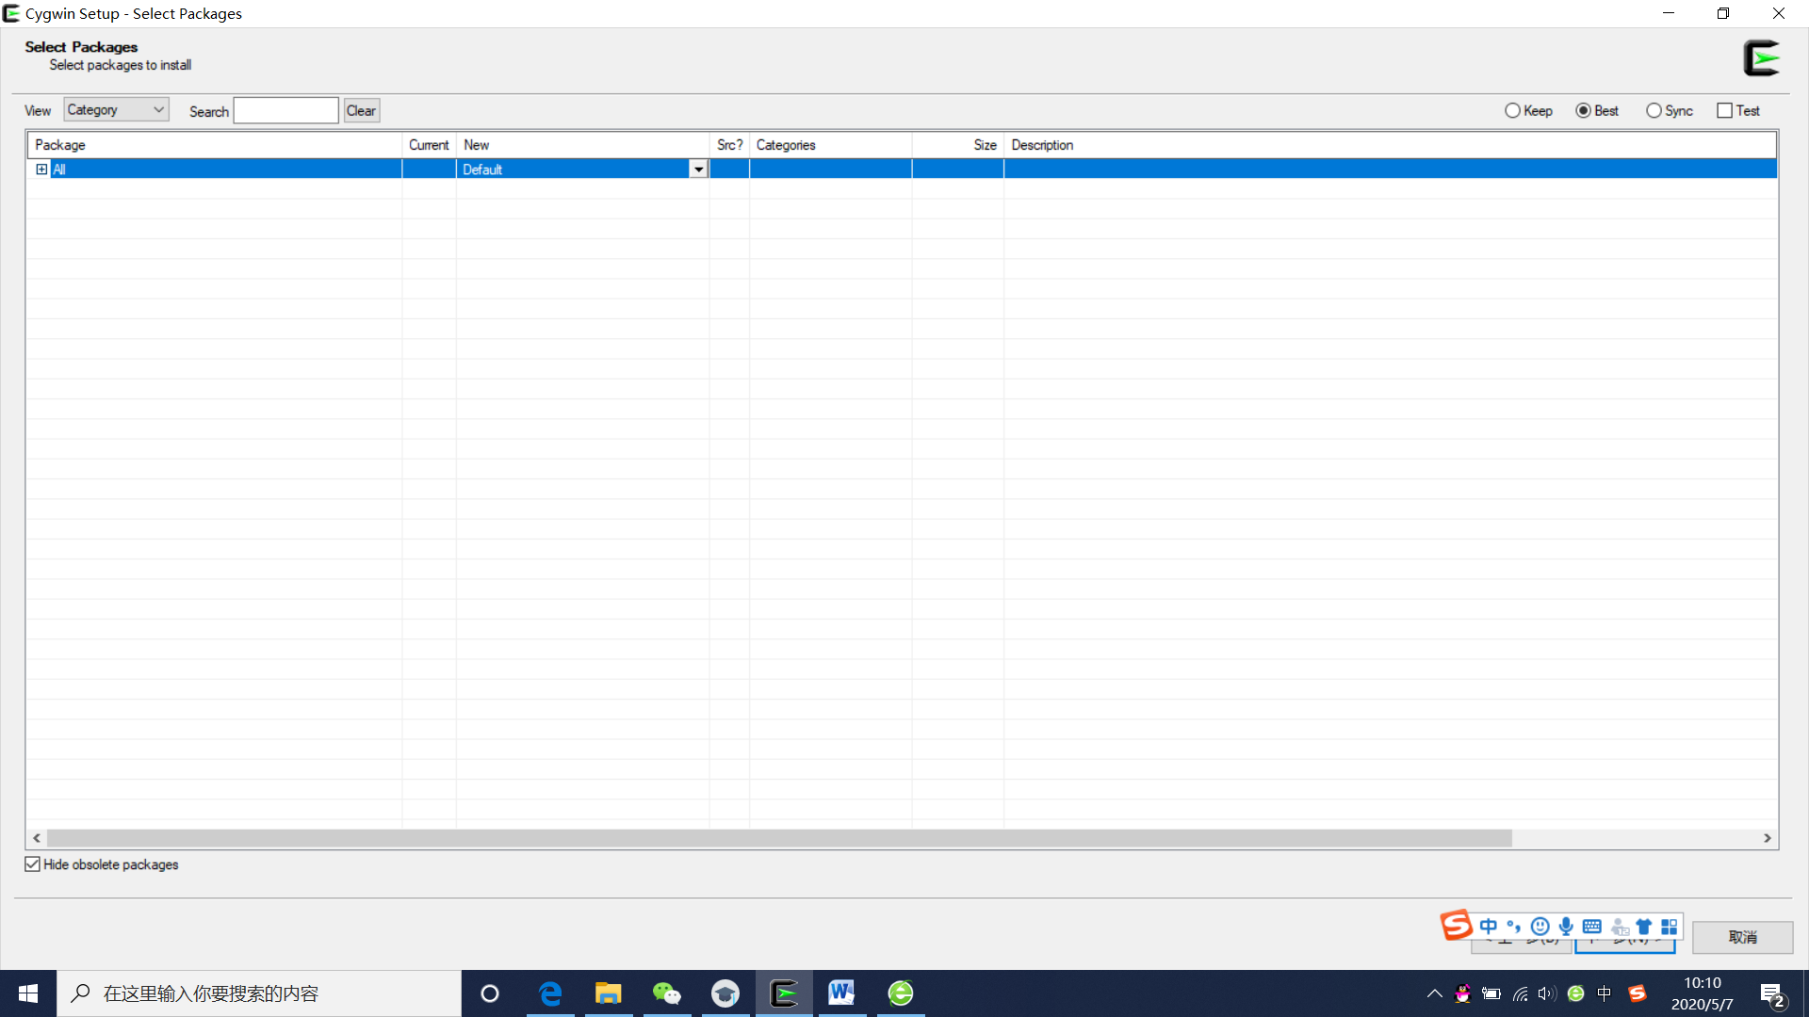
Select the packages you want to install
Packages you may want to install include: binutils, gcc, mingw, gdb, make and cmake.
Click the “+” to unfold the packages

Slide 42
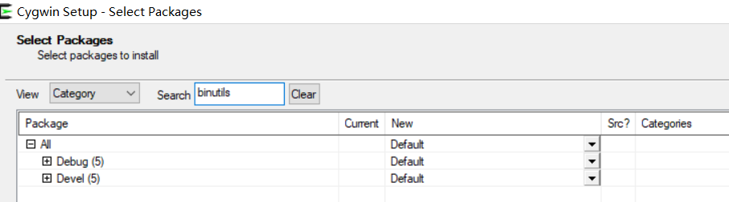
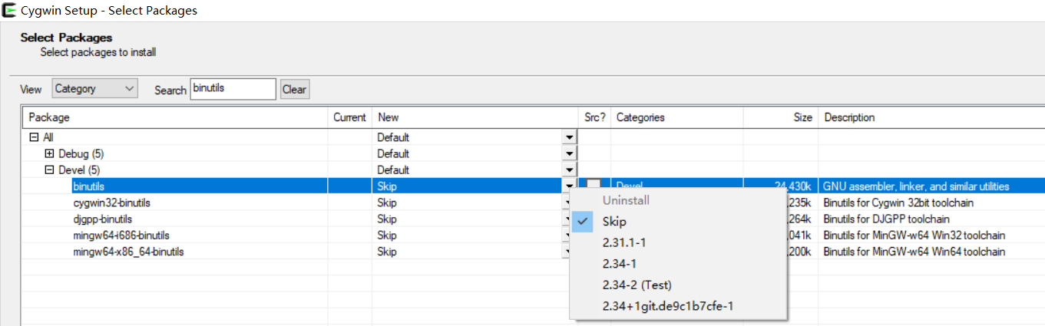
Select the packages you want to install
Packages you may want to install include: binutils, gcc, mingw, gdb, make and cmake.
Input “binutils” in the Search textbox
Click “+”
Choose “binutils”
Click the arrow, and choose 2.34-1

Slide 43
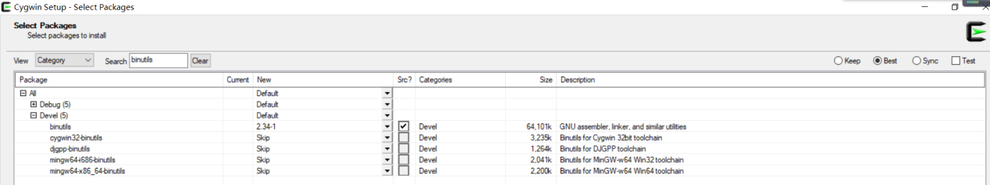
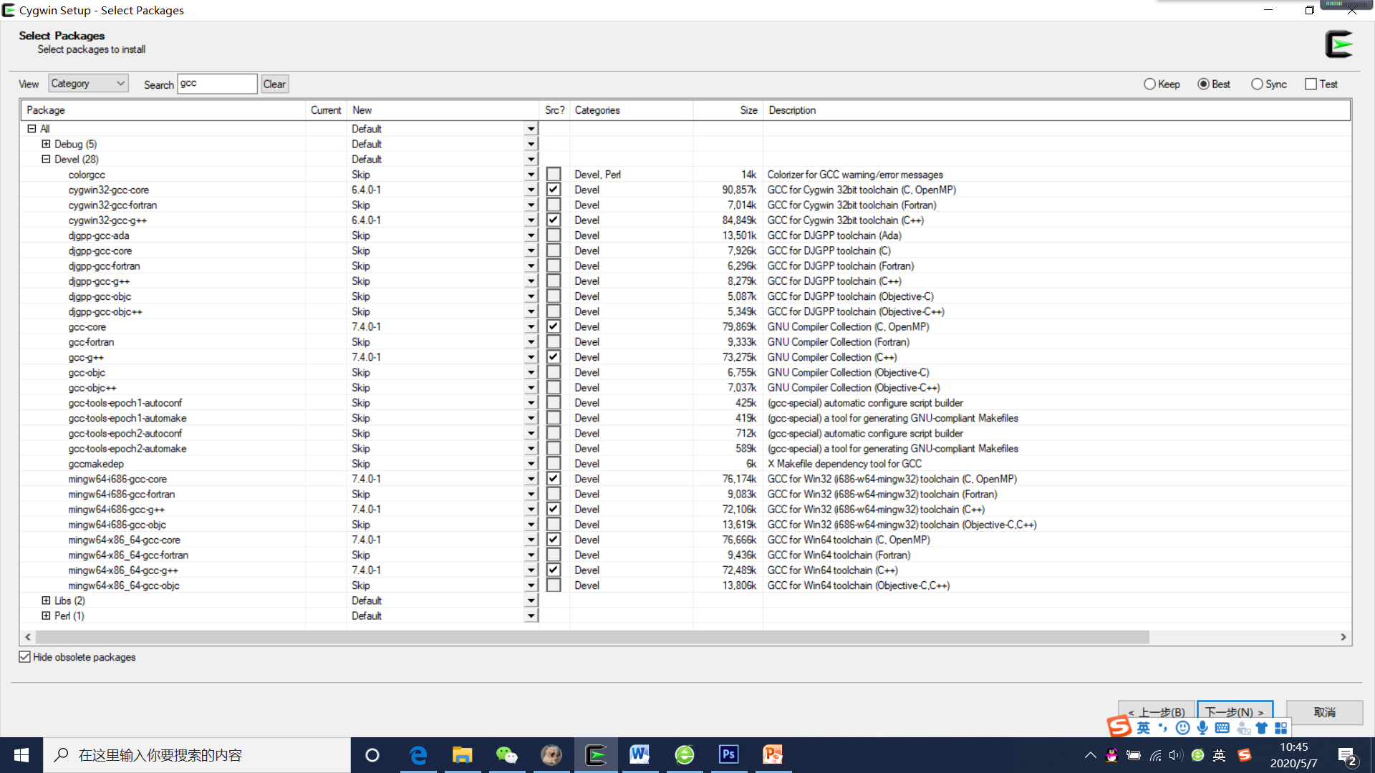
binutils
GCC
mingw

Slide 44
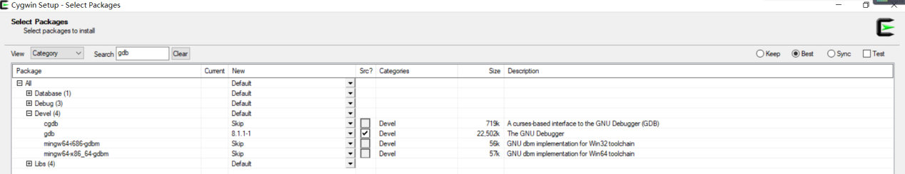
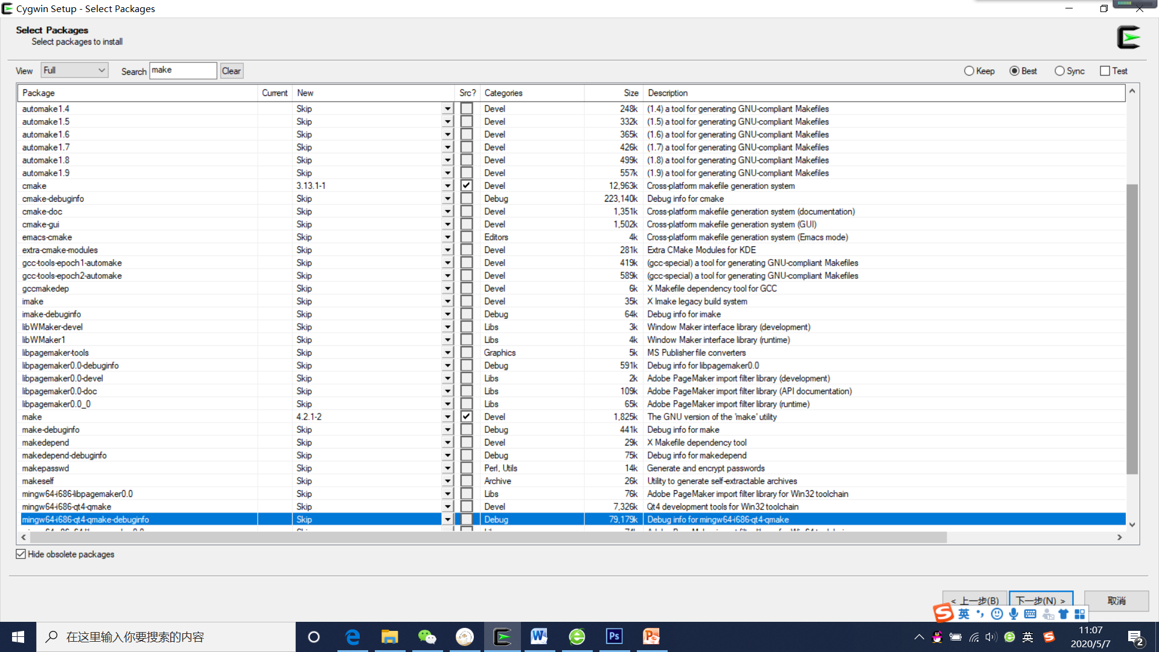
gdb
cmake
make
click Next

Slide 45
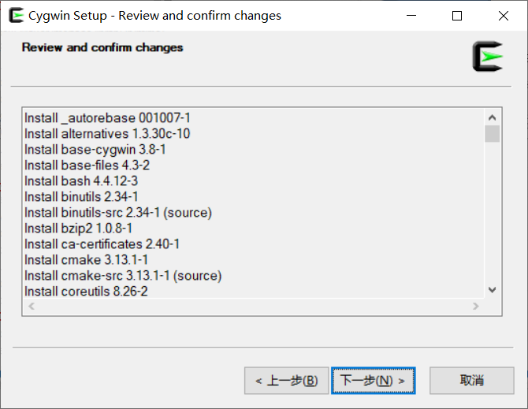
Review and confirm the changes and click Next

Slide 46
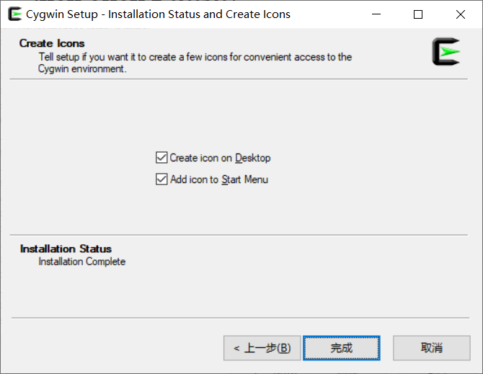
Keep the default chooses and click Finish

Slide 47
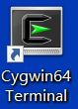
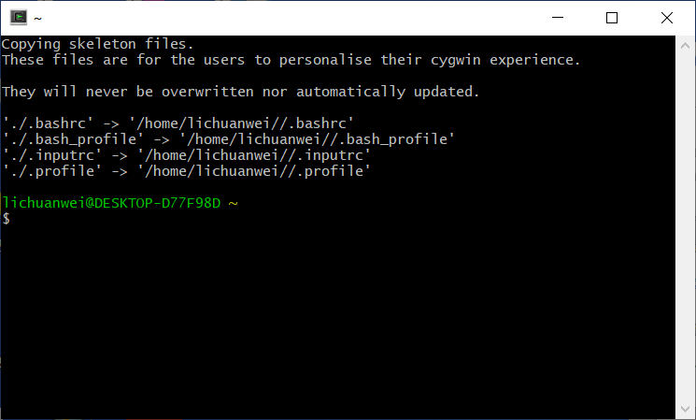
3.2 Verify Cygwin
1. Double click the Cygwin icon on the desktop to start Cygwin.

Slide 48
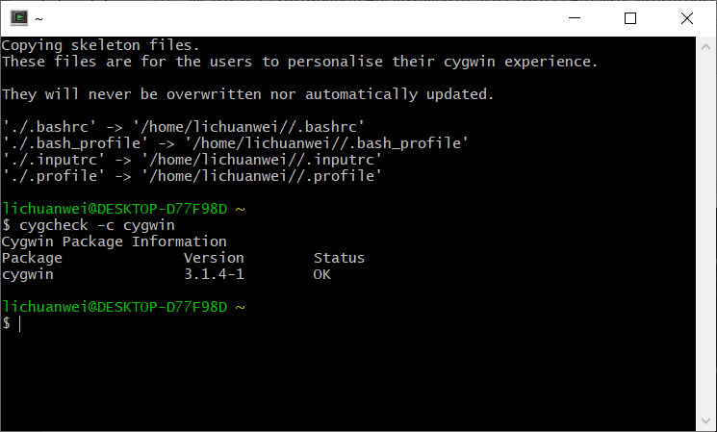
2. Input “cygcheck –c cygwin” after $ prompt.
If the Status is OK, cygwin is running fine.

Slide 49
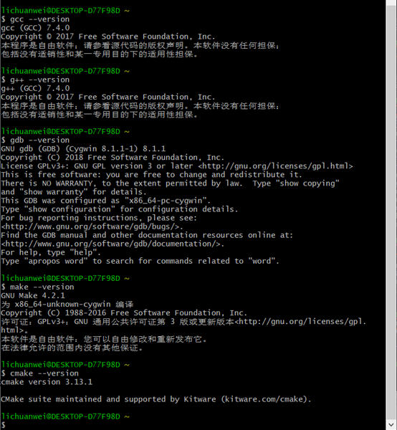
3. Verify the GCC installation by listing the version of gcc, g++, gdb, make and cmake.

Slide 50
4 Compile, Link and Run C/C++ Programs
4.1 Learn the program compilation process
4.2 Compile ,Link and Run C Programs
4.3 Compile ,Link and Run C++ Programs

Slide 51
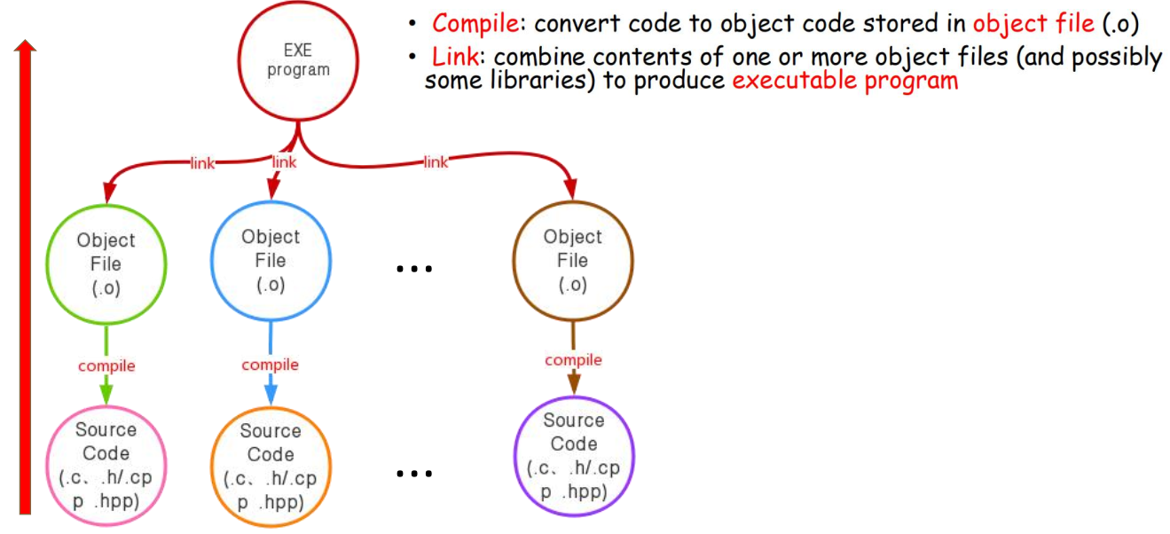
4.1 The program compilation process

Slide 52
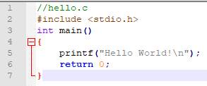
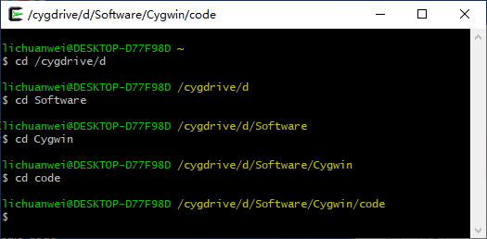
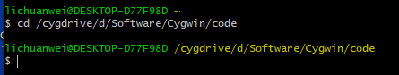
4.2 Compile, Link and Run C programs
Compile/Link/Run a simple C program – hello.c
Edit the codes below in Notepad++, and save it as hello.c to the D:\Software\Cygwin\code.
Start Cygwin, switch the current directory to the
“D:\Software\Cygwin\code” in which hello.c is stored.
or

Slide 53
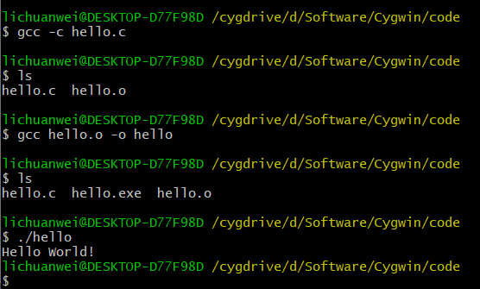
compile
link
run

Slide 54
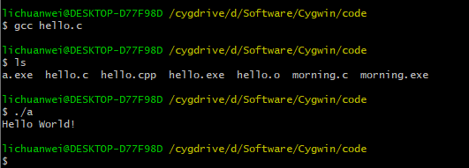
The default output executable file is called “a.exe”(Windows)
or “a.out”(Unix and Mac OS) if you don’t specify the name in
compiling and linking step.
compile and link
run a.exe

Slide 55
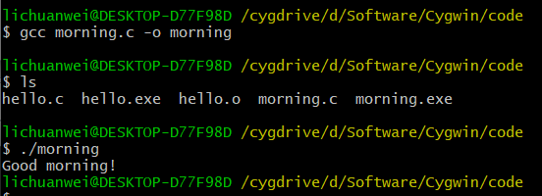
compile and link
output file name
run morning.exe

Slide 56
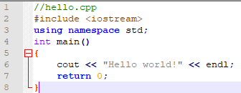
4.3 Compile, Link and Run C++ programs
Compile/Link/Run a simple C++ program – hello.cpp
Edit the codes below in Notepad++, and save it as hello.cpp to the D:\Software\Cygwin\code.
You need to use g++ to compile C++ program, as follows. We use the -o option to specify the output file name.

Slide 57
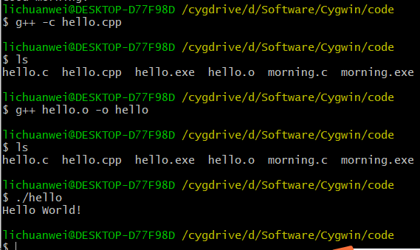
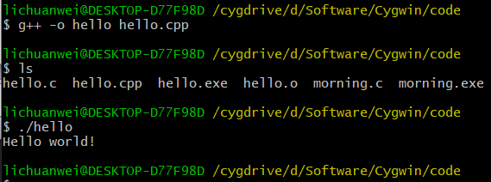
compile
link
run
compile and link
run

Slide 58


5 Download and Install Editor
To install VSCode, you can visit: https://code.visualstudio.com/ to download the package for your platform (Linux, Windows or macOS).
After you install VSCode, we need to install two plugins at least to support our development:
1. C/C++ plugin
2. Remote - WSL plugin
To install them, you can search c++ and wsl respectively.

Slide 59

5.Download and install editor (Cont.)
Now, you need to switch your VSCode to WSL system.
Click the green button on the bottom. And choose Remote WSL: New window (or others you need).

Slide 60

5.Download and install editor (Cont.)
Now your VSCode is working on the WSL system. We can create our first C program. We strongly recommand you to find more functions of VSCode, OPEN TERMINAL etc,.
Note: The suffix of the program must be .c or .cpp for c program and c++ program respectively.

Slide 61

C/C++ program’s structure

Slide 62



Slide 63
C++ Source Code Style
One statement per line
An opening brace and a closing brace for a function, each of which
is on its own line
Statements in a function indented from the braces
No whitespace around the parentheses associated with a function
name

Slide 64
Basic commands of Linux
ls （小写字母L 小写字母S） #以默认方式显示当前目录文件列表 ls –a #显示所有文件包括隐藏文件 ls –l #显示文件属性，包括大小，日期，符号连接，是否可读写及是否可执行
-----------------------------------------------------------------------------------------------------------
cd dir #切换到当前目录下的dir目录 cd / #切换到根目录 cd .. #切换到到上一级目录 cd ../.. #切换到上二级目录 cd ~ #切换到用户目录，比如是root用户，则切换到/root下
------------------------------------------------------------------------------------------------------------
rm file #删除某一个文件 rm -fr dir #删除当前目录下叫dir的整个目录
-------------------------------------------------------------------------------------------------------------
cp source target #将文件source 复制为 target cp /root/source . #将/root下的文件source复制到当前目录
NOTE: Each lab attendance will be recorded by the submission of the lab exercise.

Slide 65

6 Exercises
1. Write a program to print your name and address.
2. Many studies suggest that smiling has benefits. Write a program that produces the following output:
Have the program define a function that displays the string Smile! once, and have the program use the function as often as needed.

